Slide 1
Recommendations of the North Carolina
Ecological Flows
Science Advisory Board
Instream Flow Council Biennial Meeting
June 2, 2014
Chris Goudreau
N.C. Wildlife Resources Commission

Slide 2
Background
Session Law 2010-143
Requires DENR to develop basinwide hydrologic models for each of the 17 major river basins in NC
Simulate flows to determine if adequate water is available to meet all needs, including essential water uses and ecological flows
Does not:
  replace site-specific studies
  vary existing permits/licenses

Slide 3
What are Ecological Flows?
The Session Law defines ecological flow as “the stream flow necessary to protect ecological integrity.”
Ecological integrity is defined (in S.L.) as “the ability of an aquatic system to support and maintain a balanced, integrated, adaptive community of organisms having a species composition, diversity, and functional organization comparable to prevailing ecological conditions and, when subject to disruption, to recover and continue to provide the natural goods and services that normally accrue from the system.”
“prevailing” not in original def. (Karr and Dudley 1981)

Slide 4
Ecological Flows Science Advisory Board
SL 2010-143 directed DENR to “create a Science Advisory Board to assist the Department in characterizing the natural ecology and identifying the flow requirements.”
Role:
  water resource planning
  recommend scientifically-based methods or approaches and ecological flow requirements
Not a role:
  water-use permitting
  recommending how DENR responds to a water-availability issue
  advising DENR on how to use the EFSAB recommendations

Slide 5
Makeup of the EFSAB
  Academic Research – Duke University
  Agriculture – NC State University; NC Division of Soil and Water Conservation
  Electric Public Utilities – Duke Energy Carolinas
  Environmental NGOs – Environmental Defense Fund; The Nature Conservancy
  Local Governments – Hazen & Sawyer; Mecklenburg County
  NC American Water Works Association – CH2M HILL
  NC Division of Water Resources
  NC Division of Water Quality
  NC Environmental Management Commission
  NC Forestry Association – NC Forest Service; USDA Forest Service
  NC Natural Heritage Program
  NC Marine Fisheries Commission – East Carolina University; NC Division of Coastal Management
  NC Wildlife Resources Commission
  US Geological Survey
  US Fish and Wildlife Service
  US National Marine Fisheries Service
  Facilitation provided by N.C. State University’s Natural Resources Leadership Institute and NCSU Cooperative Extension
  Met 28 times between November 2010 and October 2013

Slide 6
ELOHA (Ecological Limits of Hydrologic Alteration)
Start with regional hydrologic models
Identify stream types expected to respond differently to flow alteration
Model ecological responses to flow alteration for each stream type
Use ecological models with socially-determined objectives to decide on flow requirements
Monitor outcomes, improve models, repeat

Slide 7
Advancing the Science:
Stream Classification
DWR worked with a consultant to characterize and classify North Carolina streams based on flow characteristics from USGS gage data
Resulted in a classification scheme comprised of seven stream classes that generally reflected stream size and flow stability

Slide 8
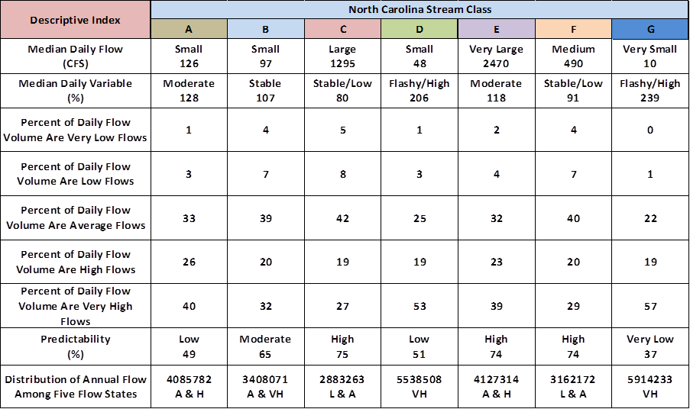
Class Characteristics – Hydrologic

Slide 9
Advancing the Science:
Stream Classification
Problems
Classes generated from hydrology derived from USGS gages often differed from hydrology created from the WaterFALL rain-runoff model
Stream hydrology classification approach should not be extrapolated beyond the USGS gages to ungaged sites
Dropped this approach

Slide 10
Types of Eco-flow Recommendations
Minimum Flow Threshold
Statistically-based Standard
Percent of Flow Standard

Slide 11
Strategies to Determine Ecological Flows
Reviewed many other states and regions
Habitat response models
  Habitat quantity and quality are measured relative to flow
  Indirect and intermediate measure of expected biological response
Biological response models
  Composition and structure of the biological community is measured relative to flow

Slide 12
Strategies to Determine Ecological Flows
Coastal systems
  Low gradient and tidally-influenced streams function differently from other inland streams
  Flow may play a secondary role to other factors including tides, salt concentration, and community structure and function
Approaches
  Inflow-based – keep flow within prescribed bounds
  Condition-based – set flow to maintain a specified condition (e.g., salinity) at a given point in the estuary
  Resource-based – sets flow based on the requirements of specific resources (e.g., shrimp)

Slide 13
Advancing the Science:
Flow-Habitat Relationships
Habitat response models
  Uses a suite of biota habitat preference curves to ensure that all types of habitat are represented
  PHABSIM
    Common habitat model
    Used in NC for hydro relicensing and water withdrawal studies

Slide 14
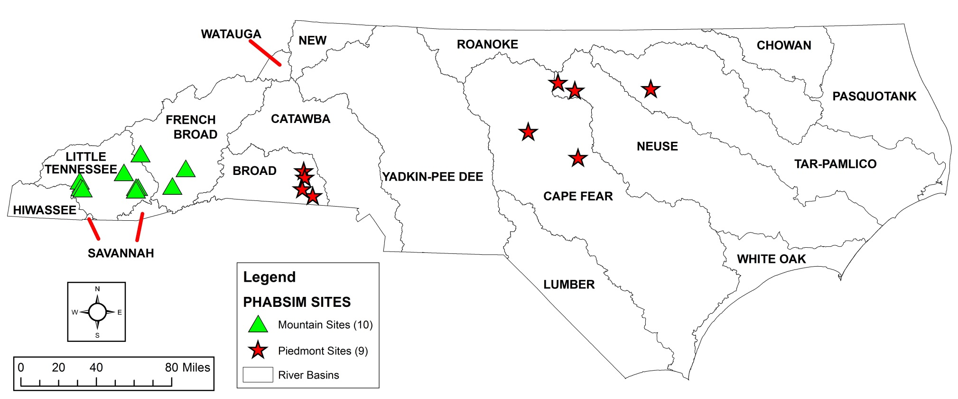
Flow-Habitat Studies in NC

Slide 15
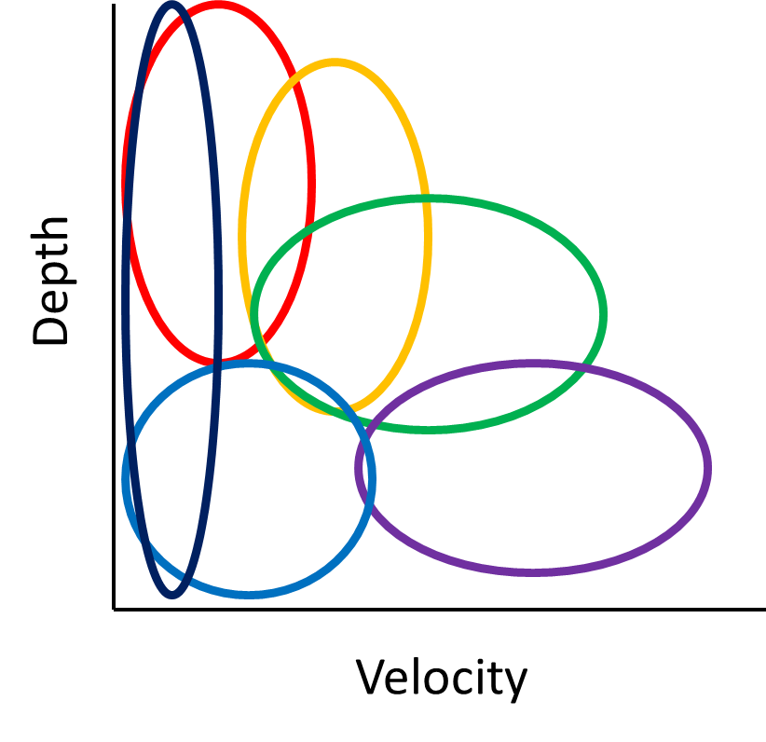
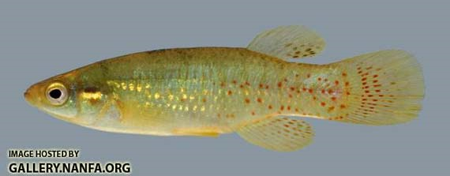
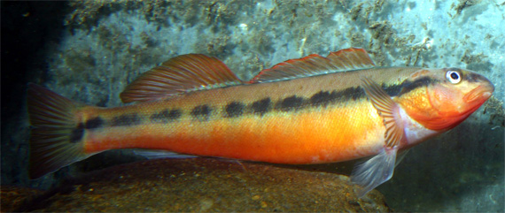
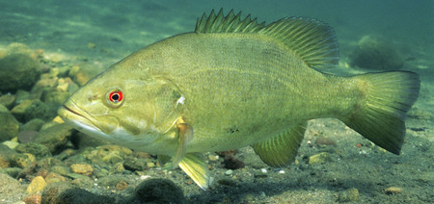
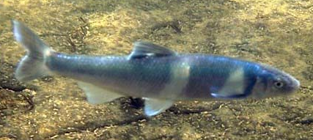
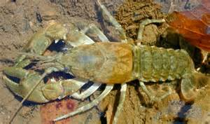
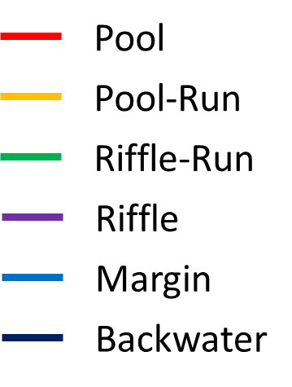
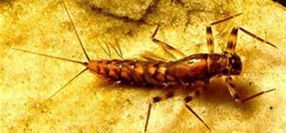
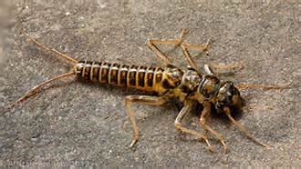
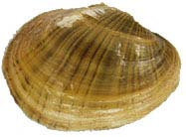
Advancing the Science:
Flow-Habitat Relationships

Slide 16
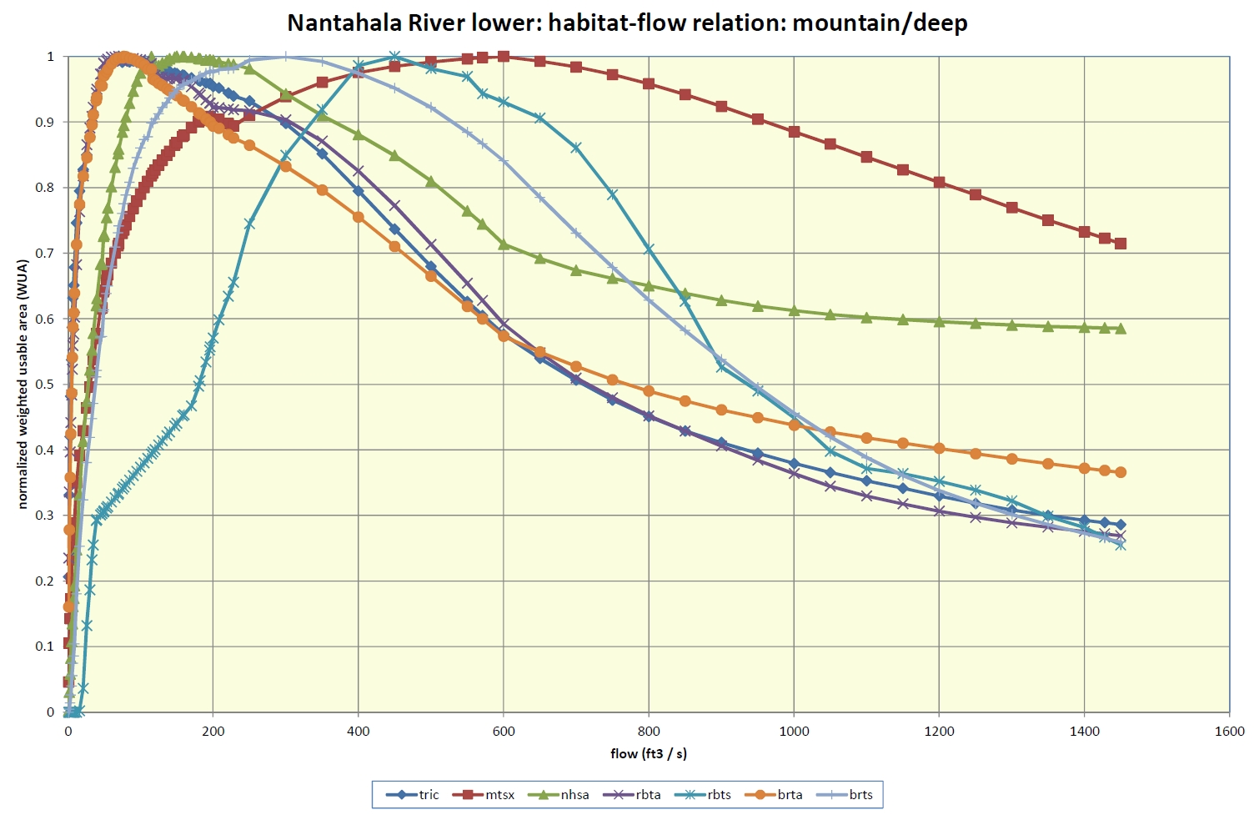
Advancing the Science:
Flow-Habitat Relationships

Slide 17
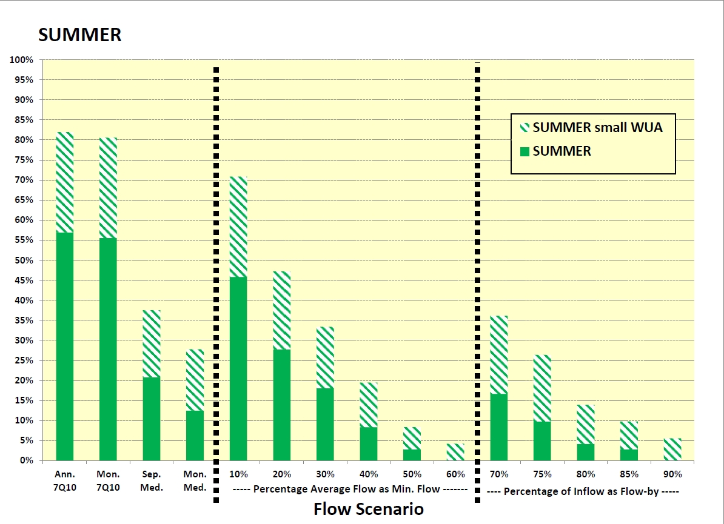
Percent of Piedmont Sites not Protecting 80% of Habitat for Deep Guild
Notes:
15 flow scenarios; 3 groups;
mountain and piedmont;
Shallow and deep guild groups (each with 7-12 species/lifestages)
4 seasons

Slide 18
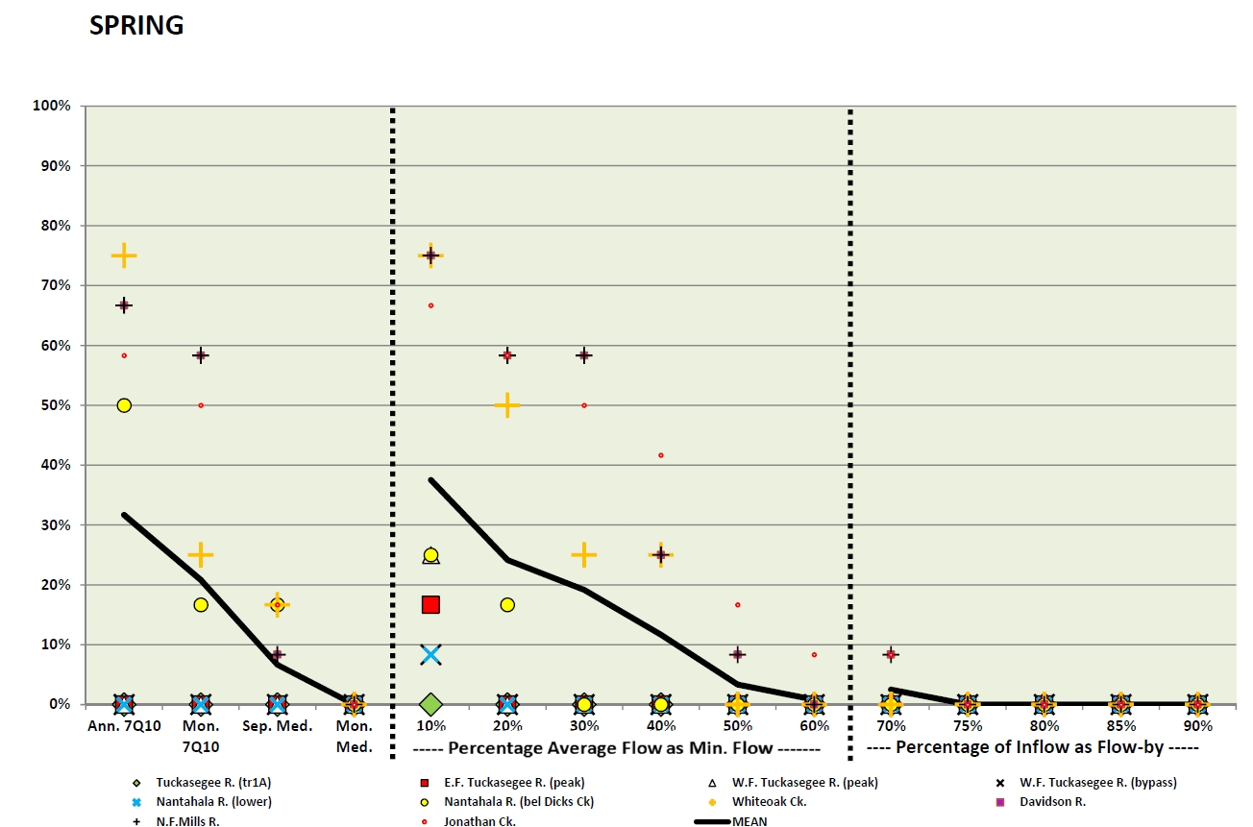
Percent of Mountain Sites not Protecting 80% of Habitat for Shallow Guild

Slide 19
Advancing the Science:
Flow-Habitat Relationships
Generally, flow scenarios that deviate most from the unaltered condition were least protective of habitat
(i.e., more water is better)
Less clear, which flow scenarios were consistently best when considering all permutations of region, season, guild group
More could be done to expand the number of sites, but these are intensive efforts; the easiest sites have been done

Slide 20
Advancing the Science:
Flow-Ecology Relationships
Ecological integrity inferred from fish or benthic macroinvertebrate community structure metrics
Two basic approaches
  Relate biological conditions to flow across a range of flow conditions (space for time)
  Relate changes in biological condition to flow at a site over time
Organizations outside of the EFSAB tried both approaches and reported their results to the Board
  RTI International (RTI) and USGS – used space for time
  The Nature Conservancy – used both approaches

Slide 21
Advancing the Science:
Flow-Ecology Relationships
649 fish and 1,227 benthos “wadeable” sites across NC
RTI/USGS conducted numerous statistical analyses to find meaningful relationships between fish/benthos and flow metrics
Significant relationships were found between six flow metrics and:
  Shannon-Weaver Diversity Index of the riffle-run fish guild
  EPT taxa richness
Flow metrics – annual and seasonal ecodeficits and reductions in the average 30-day minimum flow
Attempted to include other explanatory factors (e.g., stream size and basin characteristics), but these were unsuccessful

Slide 22
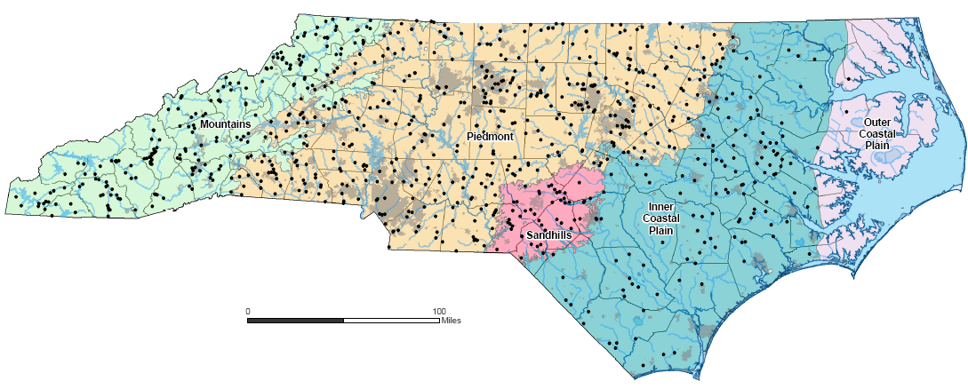
Fish Dataset
NCDWQ wadeable streams data; not trout

Slide 23
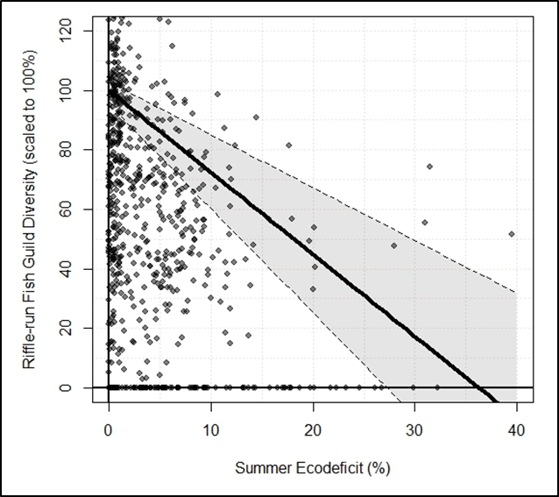
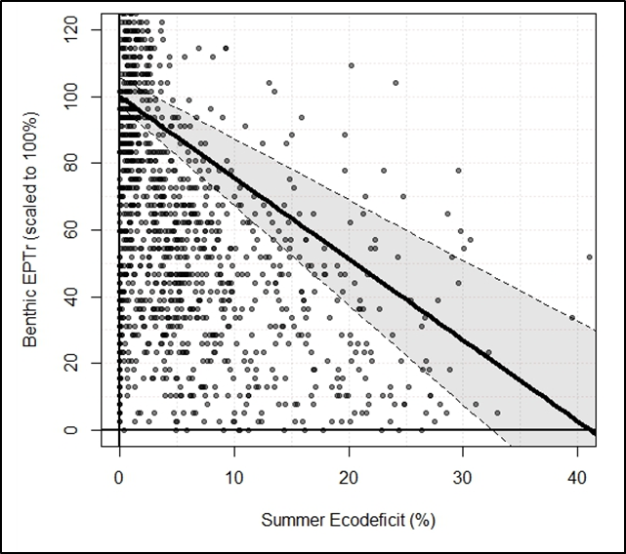
Advancing the Science:
Flow-Ecology Relationships
Fish
Benthos

Slide 24
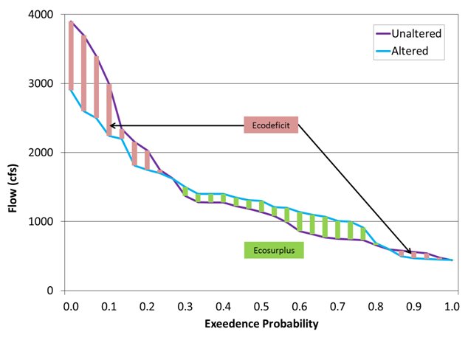
Advancing the Science:
Flow-Ecology Relationships
Ecodeficit – sum of reductions in flow between altered and unaltered flow duration curves
Auto-correlation among 100+ flow metrics

Slide 25
Advancing the Science:
Flow-Ecology Relationships
The Nature Conservancy
  Fish diversity and abundance
  141 wadeable sites in Roanoke, Cape Fear, Tar, and Little Tennessee basins
  Compared to flow for the period of 1992 – 2009
Many sites saw little change in fish diversity/abundance over time
  However, fish abundance and diversity declined in portions of the Cape Fear and Tar basins
To understand the direct influence of water withdrawals, only sites located downstream of known water withdrawals were analyzed further (N=14)
Negative relationship between fish diversity and the relative size of the water withdrawal; statistically significant, but low explanatory power
  10% ↓in MAF → 5-10% ↓ in species diversity
  50% ↓in MAF → 25- 30% ↓ in species diversity

Slide 26
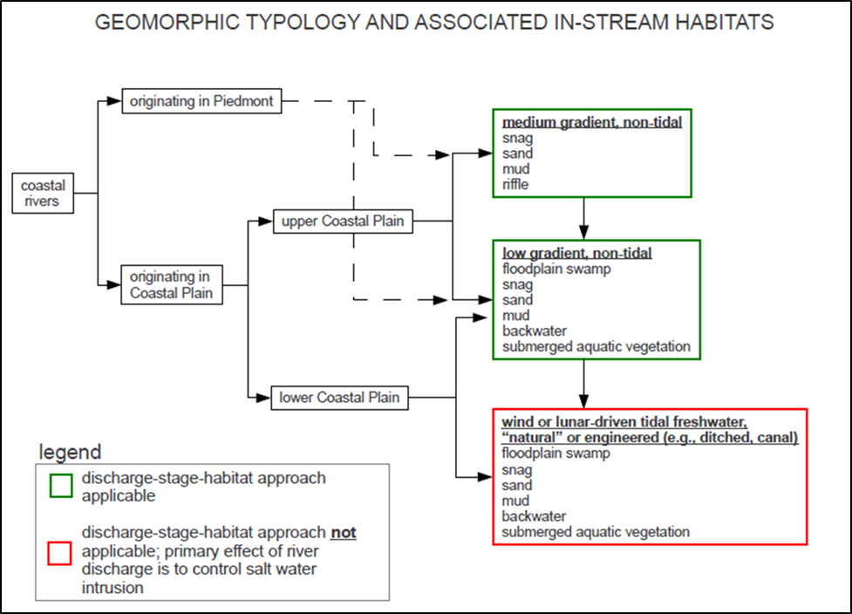
Advancing the Science:
Coastal Considerations

Slide 27
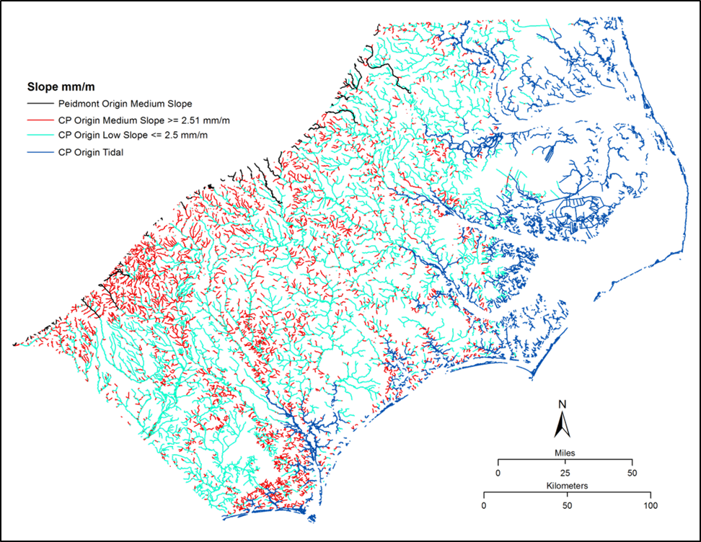
Advancing the Science:
Coastal Considerations

Slide 28
EFSAB Recommendations:
Ecological Flow Standard
Percentage of Flow (1)
Default statewide approach
80-90% of the instantaneous modeled baseline flow
Why a range?
  No apparent threshold from habitat response analyses
  Flow-by percentages >80% were most consistently protective
  No consensus on a single flow-by percentage by the EFSAB
  Similar to values from other jurisdictions
DENR discretion to select the most appropriate value for planning purposes

Slide 29
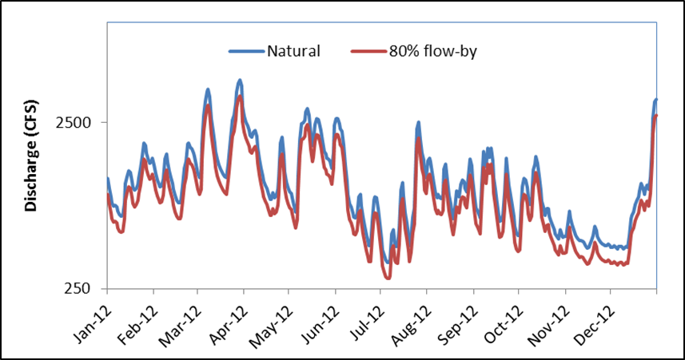
EFSAB Recommendations:
Ecological Flow Standard
Percentage of Flow (2)

Slide 30
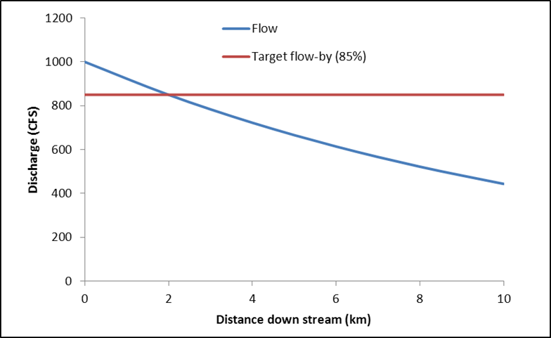
EFSAB Recommendations:
Ecological Flow Standard
Percentage of Flow (3)
“Instantaneous” = normal time step of the model (typically daily)
Model cumulative effects to avoid impacts of a series of withdrawals

Slide 31
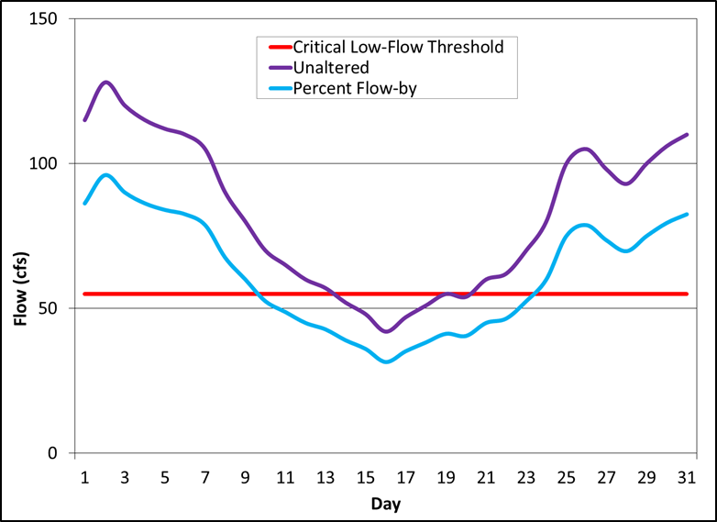
EFSAB Recommendations:
Ecological Flow Standard
Percentage of Flow (4)
Combine with a critical low-flow component
  Protect the aquatic ecosystem during periods of drought
  Prevent increasing the frequency or duration of extreme low flows that are damaging to ecosystem health
Use 20th percentile flow as a critical low flow (by month)
Ecological flow threshold is the larger of the flow-by and critical low-flow values

Slide 32
EFSAB Recommendations:
Ecological Flow Standard
Percentage of Flow (5)
Model should include following flow regimes
  natural (without any withdrawals or returns)
  baseline (with current withdrawals and returns)
  projected (with current and future withdrawals and returns)
Comparisons
  baseline:natural = how much hydrology has already been altered
  baseline:future = effects of future withdrawals and returns
Model updates should keep baseline as 2010 conditions to avoid comparisons to a continually shifting “current” condition

Slide 33
EFSAB Recommendations:
Ecological Flow Standard
Percentage of Flow (6)
Run basin model with 2 hydrology datasets – full and trimmed (10-90%)
# times threshold exceeded |  | Condition | DENR Action
Full | Trimmed
0 | 0 | Green | None
1+ | 0 | Yellow | Begin review of water usage that may be contributing to the deviations. Management tools, including water shortage and drought response plans, should be evaluated for the purpose of maintaining ecological integrity.
1+ | 1+ | Red | Additional review could include actions such as conducting site-specific evaluations or review and modeling of any biological data that are available

Slide 34
EFSAB Recommendations:
Ecological Flow Standard
Biological Response
DENR should evaluate the use of these models to assess changes in biological conditions associated with projected changes in flow
A 5-10% change in biological condition suggested as an initial criterion for further review
  Based on average range of EPT richness within the invertebrate condition classes (Excellent, Good, Good-Fair, Fair, and Poor) as defined by DENR
  The 5-10% criterion represents a change of one-quarter to one-half of the width of a condition class

Slide 35
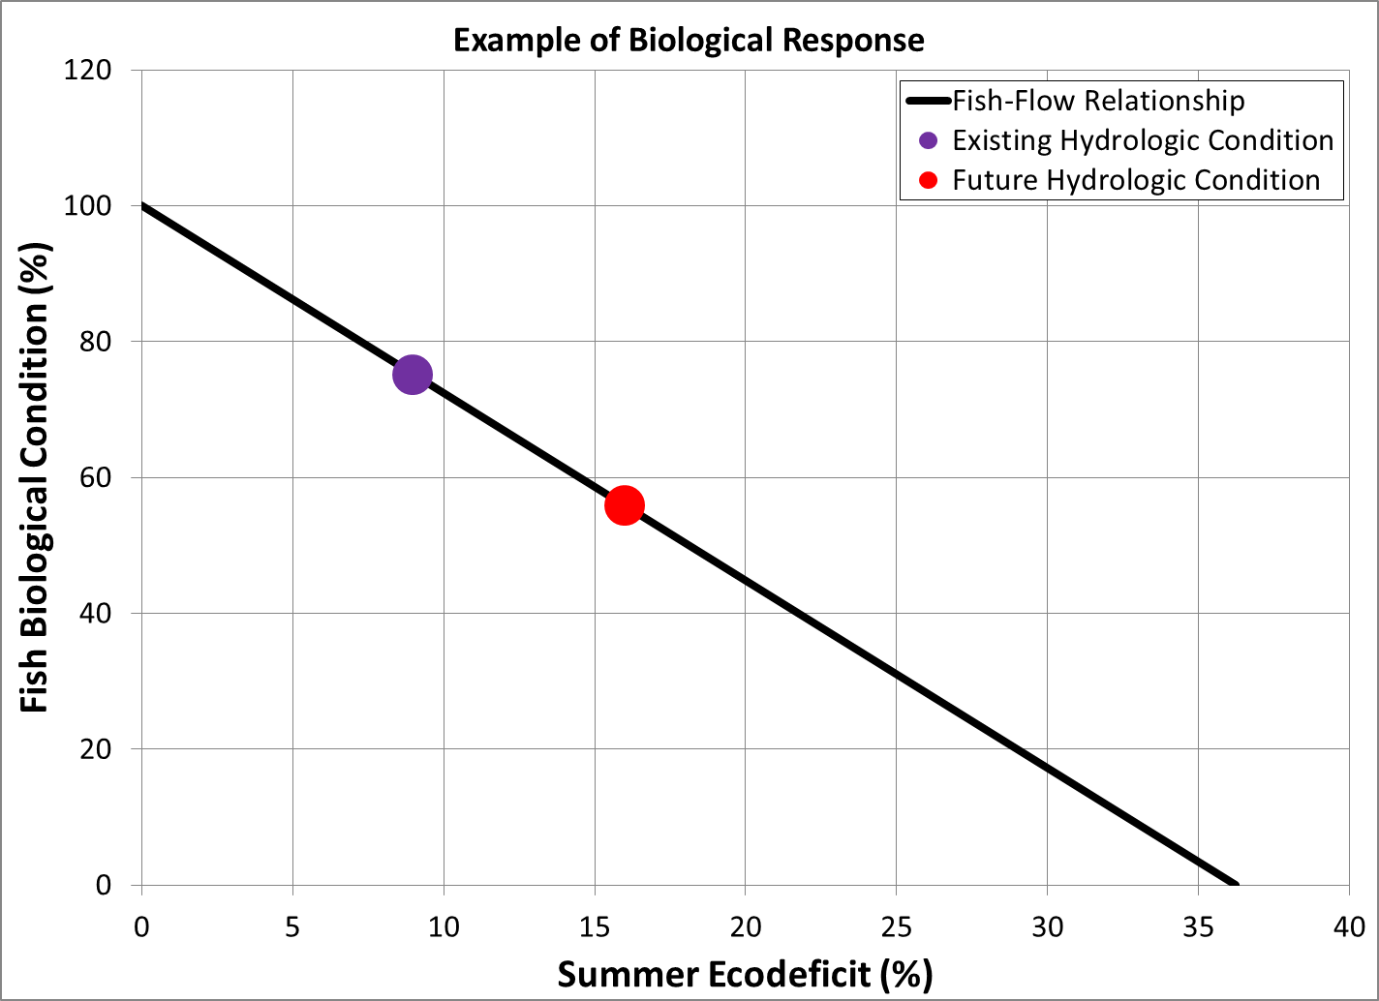
EFSAB Recommendations:
Ecological Flow Standard
Biological Response
19% ∆
Exceeds 10%
“flag”
7% ∆

Slide 36
EFSAB Recommendations:
Ecological Flow Standard
Exceptions – Coastal
No numerical standards proposed
Consider the following
Origin | Gradient | Ecological Flow Approach
 |  | Statewide Recommendation | Habitat Relationship | Downstream Salinity | Overbank Flow
Piedmont | Medium | X | X | X
Coastal Plain | Medium | X | X | X
Coastal Plain | Low |  | X | X | X
Coastal Plain | Wind or tidally driven flow |  |  | X | X

Slide 37
EFSAB Recommendations:
Ecological Flow Standard
Exceptions – Headwaters
Streams with drainage basins <10 km², DENR should conduct additional analyses to determine the potential for impact
  Limited biological and hydrologic data
  Higher vulnerability to disturbance
  Statewide approach may not adequately protect

Slide 38
EFSAB Recommendations:
Other
Listed Species
  For planning purposes, portions of basins (e.g., nodes) that include listed species should be treated by DENR as needing additional analysis in consultation with WRC, NMFS and USFWS
Adaptive Management
  Emphasize new data (hydrologic and biological) collection and evaluation in headwaters, in the coastal plain, and in large rivers
  Validate ecological thresholds
  Track impact of flow changes
  Modify characterizations, target flows, and thresholds based on new data, changing conditions and lessons learned

Slide 39
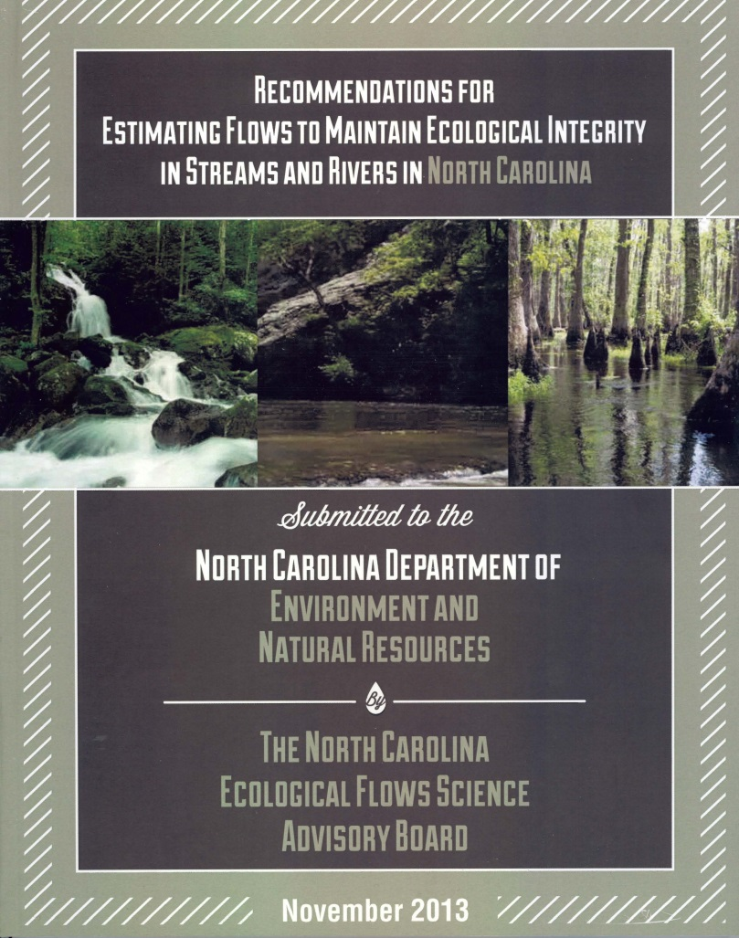
Thanks!
DWR Website of EFSAB: http://ncwater.org/?page=366
Chris Goudreau
Special Projects Coordinator
NC Wildlife Resources Commission
828-652-4360
chris.goudreau@ncwildlife.org

